Slide 1
A multi-dimensional data model
A data warehouse is based on a multidimensional data model which views data in the form of a data cube

Slide 2
Data cube
A data cube, such as sales, allows data to be modeled and viewed in multiple dimensions
Suppose ALLELETRONICS create a sales data warehouse with respect to dimensions
  Time
  Item
  Location

Slide 3
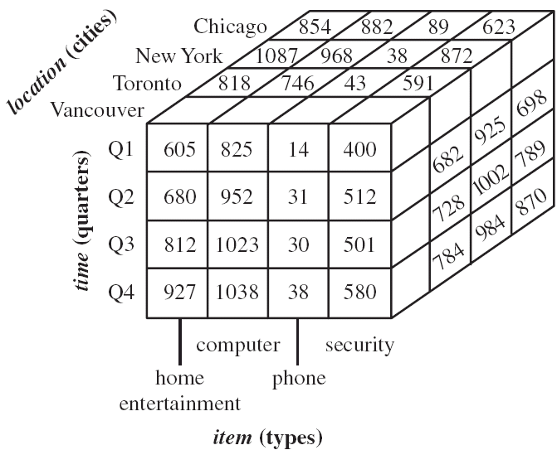
3D Data cube Example

Slide 4
Data cube
A data cube, such as sales, allows data to be modeled and viewed in multiple dimensions
Suppose ALLELETRONICS create a sales data warehouse with respect to dimensions
  Time
  Item
  Location
  Supplier

Slide 5
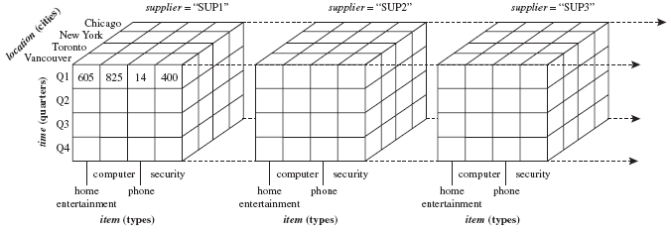
4D Data cube Example

Slide 6
Conceptual Modeling of Data Warehouses
  Star schema
  Snowflake schema
  Fact constellations

Slide 7
Conceptual Modeling of Data Warehouses
Star schema: A fact table in the middle connected to a set of dimension tables
It contains:
  A large central table (fact table)
  A set of smaller attendant tables (dimension table), one for each dimension

Slide 8
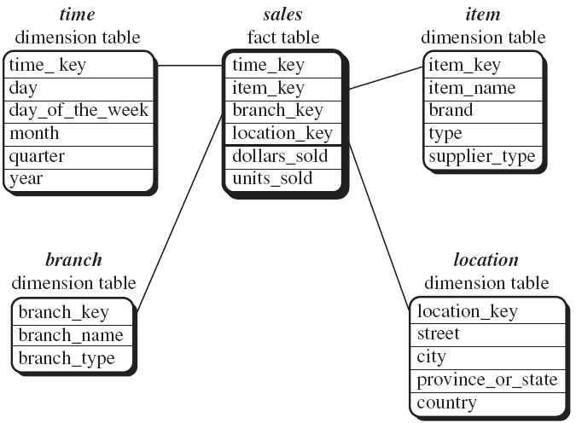
Star schema

Slide 9
Conceptual Modeling of Data Warehouses
Snowflake schema: A refinement of star schema where some dimensional hierarchy is further splitting (normalized) into a set of smaller dimension tables, forming a shape similar to snowflake
However, the snowflake structure can reduce the effectiveness of browsing, since more joins will be needed

Slide 10
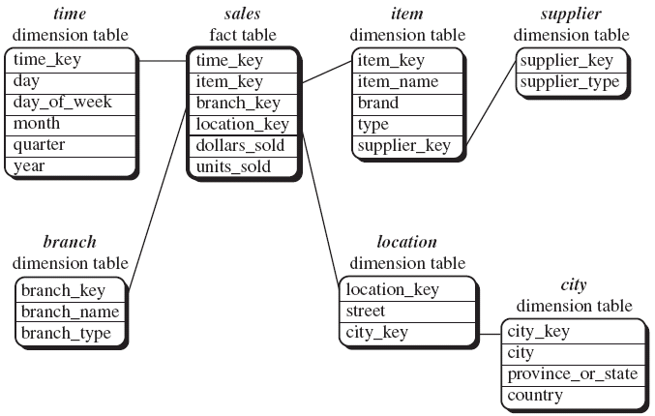
Snowflake schema

Slide 11
Conceptual Modeling of Data Warehouses
Fact constellations: Multiple fact tables share dimension tables, viewed as a collection of stars, therefore called galaxy schema or fact constellation

Slide 12
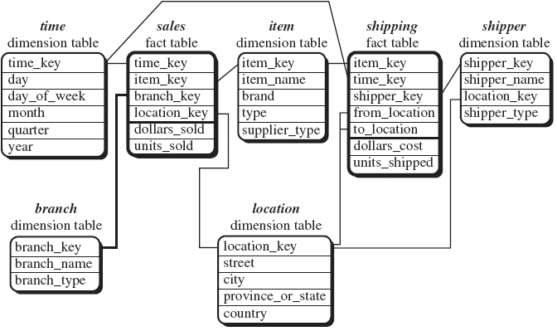
Fact constellations

